Slide 1

California Snowpack
Week 4 Presentation​​
Malachy Moran, Kayla Wopschall, Derrick Hee, Tilman Bayer

Slide 2
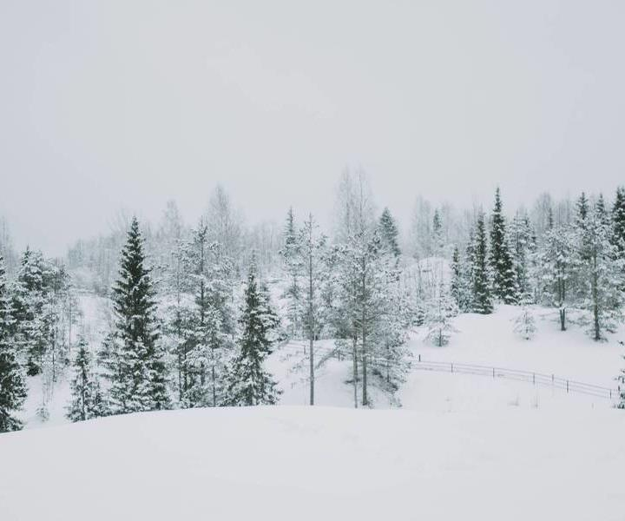
Week 3
Reviewed previous group’s paper as well as their reference papers
Met with Profs. Manuela and Paolo to ask some questions about the project
Decided to utilize Snowcast Showdown competition as an intermediary point for this project
Discussed project timeline
Discussed and assigned preliminary project roles
Filled out Team Agreement

Slide 3
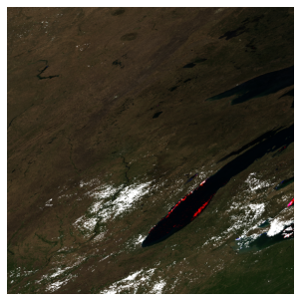
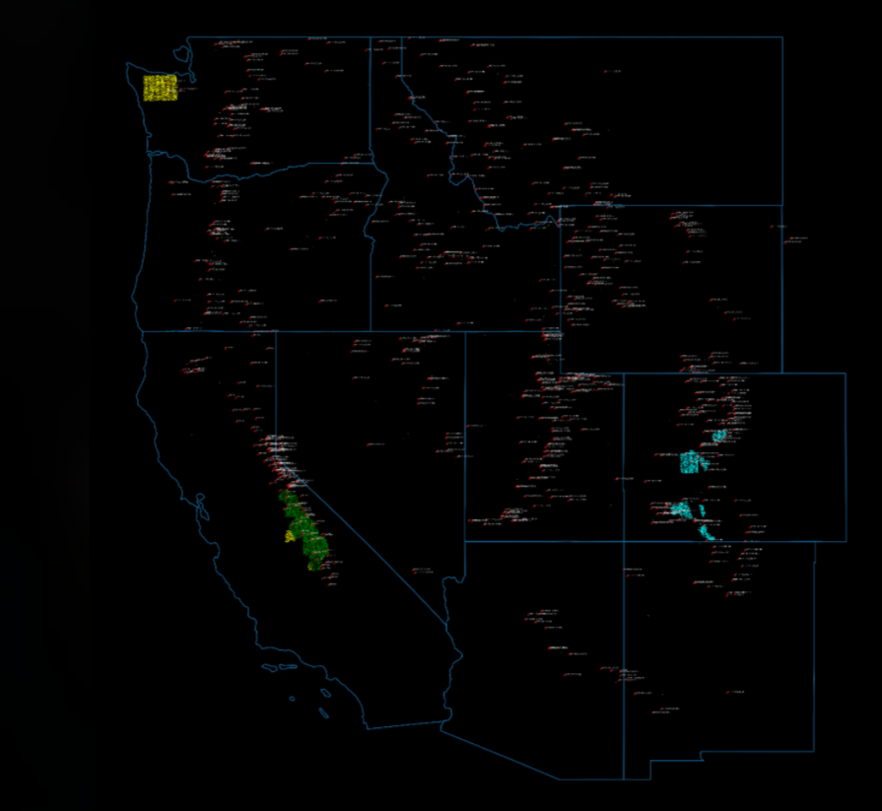
Initial Data Inspection
Initial Inspection of the data revealed that the areas of interest are in three main mountain ranges.
Created Script to calculate average measurements from the 5 closest ground stations to the cell of interest
Pulled in imagery from the MODIS satellite based on the centerpoint of the prediction cell

Slide 4


Meeting with Dr. Manuela Girotto and Dr. Paolo D'Odorico
Problem: Snow as a natural reservoir
Desired outcome:
Forecasting tool. Being able to predict water that is going to enter reservoirs for use.
Ideally this prediction would be seasonal, on the scale of weeks to 3 months.
SWE challenge is a good starting point, which can also pivot to a Sierra-specific model
Additional datasets were brought up (Sentinel-1, Sentinel-2 SAR images) for consideration
Notes:
: Snow acts like a natural reservoir that stores water when it is plentiful in the winter months and releases it over time into man-made reservoirs and groundwater as snowmelt increases to a peak in the spring months. This snowmelt is a vital source of water for high altitude flora as well as an increasingly important value to know for water management over the course of a year. This is especially true as climate change is altering how much water is available in these natural reservoirs.
Project can be broadly divided into two steps:
Model to predict snow water equivalent (SWE) from variables (image data, elevation, thermal etc.)
SWE conversion to streamflow, or water that actually makes it into groundwater

Slide 5
Week 4
Continued Data Wrangling
Shift to using Google Earth Engine
Satellite image slices
Rain Shadow annotation for stations
Notes:
Modis:
5x5 image with rgb representing ['NDSI_Snow_Cover', 'Snow_Albedo_Daily_Tile', 'NDSI']
and the measurement area in the center square

Slide 6

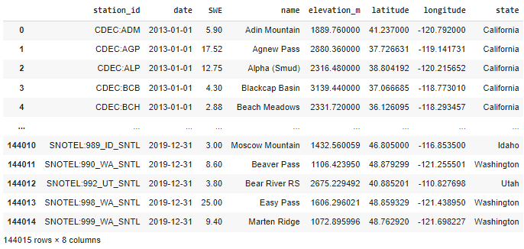
Exploratory Data Analysis
Dataset Preview
Sampling Points
Unique sampling location ID
X-Y coordinate data (Lat/Long)
Station Information
Real sample at X date
Additional station metadata (X,Y,Z)
Some stations do not have measurements on certain days
Results in NaN cells when merging with Sampling Points

Slide 7
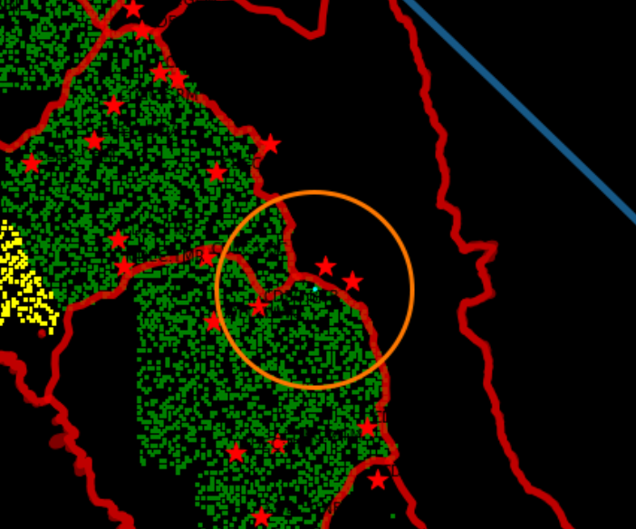
Pairing Station to Sample location
Essentially taking a K-Nearest-Neighbors approach
We are interested in stations that are close to the sample point as they will be most representative of the actual SWE
We are planning on weighing the measured SWE from each station based on the distance away the station is from the sampling location
This will provide some variation in the samples, otherwise each cluster of sampling spots will have the exact same estimated SWE
Taking from multiple stations also addresses NaN measurements seen in EDA

Slide 8
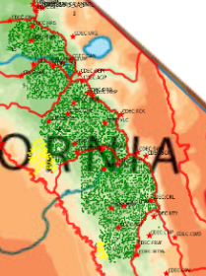
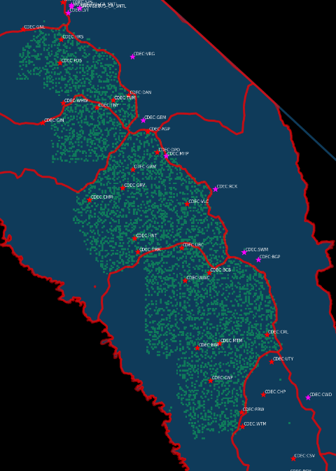
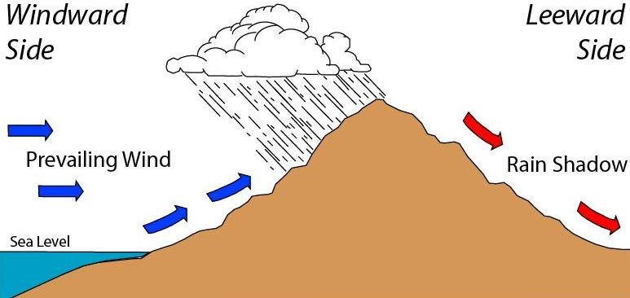
Why Rain Shadow?
There is a marked difference in precipitation due to mountains
As clouds are forced over mountains, they release their payload in the form of precipitation. As a result, there is a noticeable decrease on the opposite side of the mountain
Some stations are expected to fall in the rainshadow
As a result, their measurements might not be reflective of what we actually will observe in a nearby sample on the opposite side
Meg Stewart - https://www.flickr.com/photos/megstewart/8644087724/

Slide 9
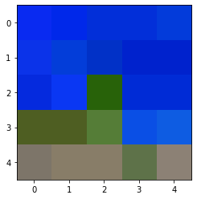
Satellite Images

